Slide 1
State of Texas v. (Your Defendant)
Cause Number
(your Cause number here)

Slide 2
State of Texas v. Otis T Drunk
In Lone Star County, Texas
The defendant, Otis T Drunk
On or about April 25th, 2009
Operated
A Motor Vehicle
In a Public Place
While Intoxicated

Slide 3
Intoxicated
Texas Penal Code 49.01 (2)
(A) not having the normal use of mental or physical faculties by reason of the introduction of alcohol, a controlled substance, a drug, a dangerous drug, a combination of two or more of those substances, or any other substance into the body; or
(B) having an alcohol concentration of 0.08 or more.

Slide 4
Implied Consent Law Transportation Code 724.011(a)
0
If arrested for an offense arising out of acts alleged to have been committed while the person was (DWI) the person is deemed to have consented … to submit to the taking of one or more specimens of the person’s breath or blood for analysis to determine the alcohol concentration or the presence . . . . of a controlled substance, drug, dangerous drug or other substance.

Slide 5
Notes:
5

Slide 6
Notes:
6

Slide 7
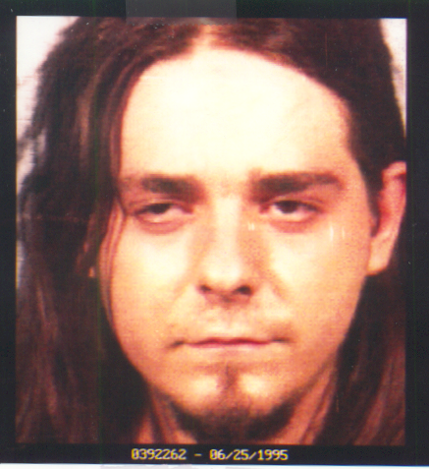
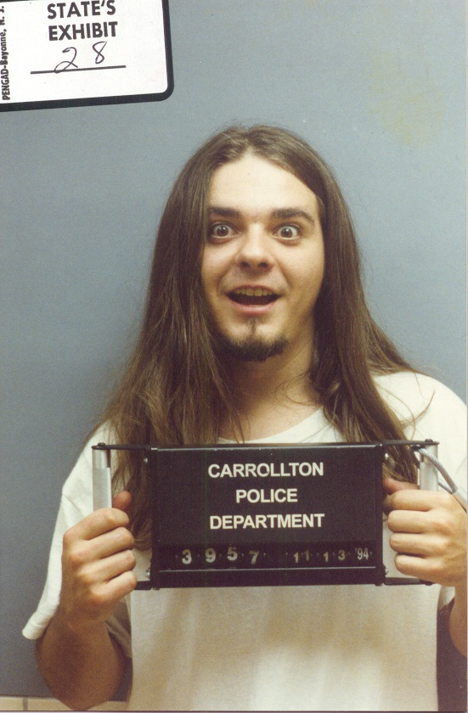
Book-In Photos
0

Slide 8
Driver’s License
9:40 pm
10:16 pm
7:30 am

Slide 9
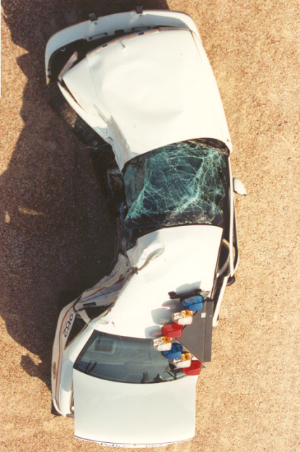
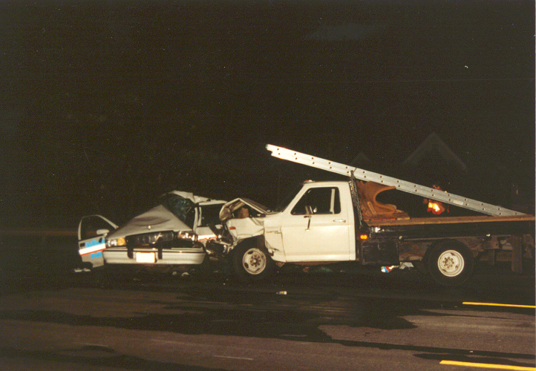
0
Diagrams
228 Feet

