Slide 1
Virtual Grand Jury

Slide 2
Legal Authority
Supreme Court’s Emergency Order #22
Order signed by the district court judges*
CCP Art. 21.011 authorizes filing an indictment in electronic form*
Can only exist so long as the emergency order authorizes it.

Slide 3
Why?
Consistency
Increased participation=Quorums
Health of participants
Reduction of backlog

Slide 4
Technology Given to Grand Jurors
Chromebook
Headphones
Gmail address linked to chromebook for session invites and daily case schedule

Slide 5
Virtual Grand Jury Platform: Cisco Webex
CJIS certified
All grand jurors faces fit on screen*
Different sound quality from Zoom
Webex link will be emailed for you to install

Slide 6
Grand Jury Process: Presentations
Email invite to join
Log on at appointed time
Can screen share/play video
Bailiff will monitor the quorum/admonish grand jury at start of session
After presentation: Bailiff will pass the host to a grand juror
Bailiff and attorney will move to the virtual lobby during deliberations
Bailiff and attorney will be readmitted to learn of vote
No bills and corrected indictments need to be sent to bailiff immediately

Slide 7
Grand Jury Process: Presentment
Bailiff will email docusign envelope(s) to foreperson containing indictments/no bills*
Once envelope is successfully opened, Bailiff will transfer the host to foreperson who will move her to the virtual lobby
Bailiff will notify clerk to be on standby.
Foreperson will share screen and sign indictments/no bills in presence of the grand jury
Last page of envelope will be document with text boxes

Slide 8
Grand Jury Process: Presentment
Textboxes will force foreperson to pause
Foreperson will admit bailiff and clerk into the virtual grand jury room.
Foreperson will fill out text boxes and hit send
District Clerk will be able to process indictments through Docusign

Slide 9
Virtual Grand Jury Guidelines

Slide 10
Grand Jurors
Can participate at their residence or at Gault grand jury room
Alone behind a closed door/out of ear shot from anyone
Wearing headphones
Face remains on screen at all times (except during scheduled breaks)
No broadcasting or recording
No “non-grand jury” related screens open
No internet sleuthing
*Designated breaks will be at 10:00 & 12:00*

Slide 11
Attorneys
May be at one of the following locations:
Residence
REB
Gault grand jury room
Alone behind a closed door/out of ear shot from anyone
Headphones are recommended*
Professional attire

Slide 12
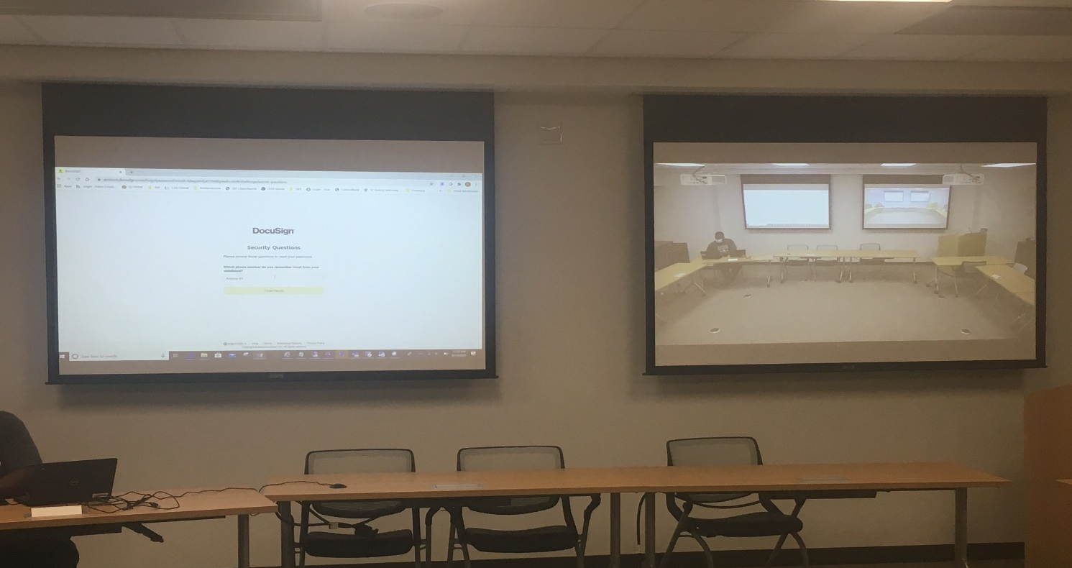
Witnesses
Attorney, court reporter, interpreter and witnesses will be in the LL training room at the REB
-All witnesses must wear masks in accordance with the Travis County orders
-Consider obtaining a court order to serve with subpoena if you think your witness won’t wear one
-Limited number of masks are available at the front desk should your witness show up without one

Slide 13
Murphy’s Law

Slide 14
Breach of Secrecy: Grand Juror & Attorneys
Person where breach occurs (or bailiff) will immediately stop the proceedings
Proceedings will continue once secrecy has been restored
Case will not be voted on but passed to a different grand jury
Declaration will be sent via Docusign to document breach/its remedy and the name of the case that was passed on

Slide 15
Technology Issues: Grand Jurors
Bailiff monitors the screens to ensure we have a quorum at all times
If a quorum is lost proceedings will pause to see if a quorum can be restored
Grand Jurors instructed to vote only on the cases where they heard the entire presentation

Slide 16
Technology Issues: Attorneys
All attorneys should be on standby at least one hour before their scheduled time
If you have a technology issue please email or text bailiff so that next presenter can present
Email Bailiff when technology is restored so you can be worked back into the session
If unable to restore cases will be passed and rescheduled

Slide 17
Indictments & Orders

Slide 18
Indictments: Intake Unit
Grand Jury Attorneys: indictments and any accompanying orders must be saved by 12 pm two business days before your presentation
Grand Jury Secretaries: must have all indictments and orders proofread and saved in the correct format by 8 a.m. the day before the presentation
Bailiff: will prepare the Docusign envelope the day before the presentation including placing the required signature fields for foreperson and clerk in each indictment

Slide 19
Indictments: Other Units
Indictments and any accompanying orders must be saved in the correct location* and saved in the correct format* by 3 p.m. two business days before your grand jury presentation
Bailiff will prepare the docusign envelope the day before the presentation—including placing the required signature fields for the foreperson and clerk in each indictment
*Please see next slides.

Slide 20
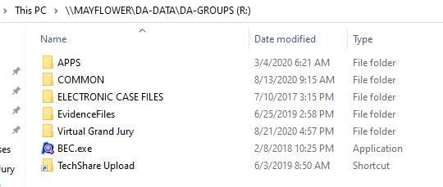
Location to Save Indictments:
*Grand Jury attorneys will save in their usual locations

Slide 21
Format to Save Indictments
*Please do not change the pre-set indictment margins.

Slide 22
Format to Save No Bills
Generated through Techshare:
More Actions:
Generate Documents
Select: “No Bill
Generate as Editable
Save as:
No Bill

Slide 23
Accompanying Orders: CA Enhancement/No Arrest
CA enhancement no arrest:
Use “Request for Capias ENH”
Generated through Techshare:
More Actions:
Generate Documents
Select: “RequestcapiasENH”
Generate as Editable
SAVE AS :
*Save in the same folder as your indictment.

Slide 24
Accompanying Orders: No Complaint/Need Arrest
Step #1: Capias Request
Generated through Techshare:
More Actions:
Generate Documents
Choose “Capias Request”
Generate as Editable
SAVE AS :
*Save in the same folder as your indictment.
Step #2: Case Synopsis (for bond determination)
SAVE AS :

Slide 25
Accompanying Orders: Reindictment
Order requesting capias or Transfering Bond
Cannot be generated through techshare
Template is in the Virtual Grand Jury Folder:
Save as:
*Save in the same folder as your indictment.

Slide 26
Accompanying Orders: DNA
For cases with the “Mandatory DNA tag”:
Generate in TS
More Actions:
Generate Documents
Choose “DNA order”
Generate as Editable
SAVE AS :
*Save in the same folder as your indictment.

Slide 27
Schedules

Slide 28
Schedule
Two weeks out of every month:
Session times moved to 9am-1pm
Time is still very tight so please plan ahead
Cannot add on a case the day of your presentation
Emergency cases at the very latest must be scheduled in Techshare and saved by 10 a.m. the day before the presentation

Slide 29
-Place Webex on your computer
-Acknowledgement of Training/Guidelines
-Ongoing Web-ex Training
Next Steps

